Slide 1
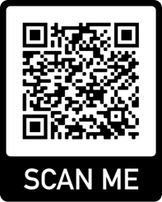
SCHOOL OF MATHEMATICS:
CODE OF CONDUCT
(A Spring Day of Combinatorics Friday, 1st March, 2024)
The School of Mathematics is committed to providing a welcoming, inclusive and safe community for all. We expect co-operation and support from all staff, students and visitors to help ensure a harassment-free environment where everyone is treated with courtesy, respect and dignity.
Examples of harassment include, but are not limited to:
  offensive or belittling comments related to age, body size, disability, ethnicity, gender, gender identity and expression, physical appearance, sexual orientation, socio-economic status and religion;
  inappropriate language (this does not need to be aimed directly at an individual(s) for it to contravene the code);
  deliberate intimidation;
  harassing photography or recording;
  inappropriate physical contact;
  unwelcome sexual or other forms of attention.
  Such behaviours are not welcome in the School of Mathematics and will not be tolerated.
Alternatively, please speak to a member of staff to whom you feel comfortable disclosing this information.
The organisers for A Spring Day of Combinatorics are Simona Boyadzhiyska (s.s.boyadzhiyska@bham.ac.uk) and Allan Lo (s.a.lo@bham.ac.uk).
The Director of Equality, Diversity and Inclusivity in the School of Mathematics is Dr Sara Jabbari in Watson 113 (s.jabbari@bham.ac.uk).
We also reject complicity that knowingly promotes, encourages, or protects discrimination or unprofessional behaviour on the part of others. Should anyone experience or witness behaviour contravening the School of Mathematics’ Code of Conduct, please intervene where you feel comfortable doing so. We strongly urge you to report this behaviour using the QR code:

